Slide 1
Daily Review
To make sure an experiment is fair, scientists must identify and control variables that may affect the experiment.
There are three types of variables in an experiment.
Independent variable: the one that is deliberately changed
Dependent variable: the one that is tested or measured
Controlled variables: the ones that are kept the same to make the experiment fair
Vocabulary
Variable: something that may affect an experiment

Slide 2
Daily Review
From the example below identify the:
Independent variable
Dependent variable
Controlled variables.
Aim: To find out if watering plants with fertiliser makes them grow faster.
Independent variable (changed): Amount of fertiliser
Dependent variable (measured): How fast the plants grow
Controlled variables (kept the same): Amount of water, Type of soil, Amount of sunlight, Type of fertiliser
Vocabulary
Variable: something that my affect an experiment

Slide 3
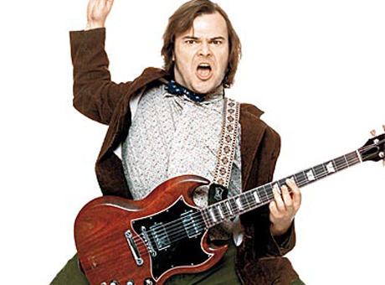
Daily Review
Classifying energy into types
Is the energy stored? Yes = potential Does the energy involve movement? Yes = kinetic Write a full sentence response: ______ is a form of _______ energy because _________.
One form of energy produced by a guitar is sound energy. What group of energy does this belong to?
Reminder
Kinetic: Movement Heat: Warms things up Light: Brightness / lets us see Sound: Vibrating objects / can be heard Electrical: Movement of electric charges Elastic: Stored in compressed / stretched objects Gravitational: Stored in objects high up Chemical: Stored in chemical bonds Nuclear: Stored inside atoms
Sound energy is a form of kinetic energy because it involves movement.

Slide 4

Daily Review
Classifying energy into types
Is the energy stored? Yes = potential Does the energy involve movement? Yes = kinetic Write a full sentence response: ______ is a form of _______ energy because _________.
Bungie cords can hold elastic energy. What group of energy does this belong to?
Reminder
Kinetic: Movement Heat: Warms things up Light: Brightness / lets us see Sound: Vibrating objects / can be heard Electrical: Movement of electric charges Elastic: Stored in compressed / stretched objects Gravitational: Stored in objects high up Chemical: Stored in chemical bonds Nuclear: Stored inside atoms
Elastic energy is a form of potential energy because it is stored.

Slide 5
Transferring and Transforming Energy Year 8 Science

Slide 6

Learning Objectives
CFU
What are we going to learn?
Identify and describe how energy can be transferred.
Identify and describe how energy can be transformed.
Activate Prior Knowledge
Cars use and produce many different forms of energy. List as many as you can think of on your whiteboard.
Think, Pair, Share: which forms of energy are used by the car? Which ones are produced?

Slide 7
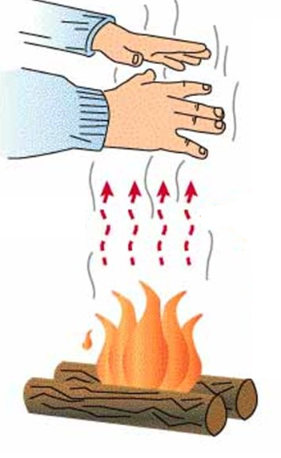

Concept Development
CFU 1
What is energy transfer?
CFU 2
Think, Pair, Share: describe two other ways that energy can be passed from one object to another.
Energy Transfer
When energy moves from one object to another without changing form, we say it has been transferred.
Examples
If you stand in front of a fire, the heat energy is transferred from the fire to you, heating you up.
When you kick a ball, kinetic energy from your foot is transferred to the ball, causing the ball to move.

Slide 8
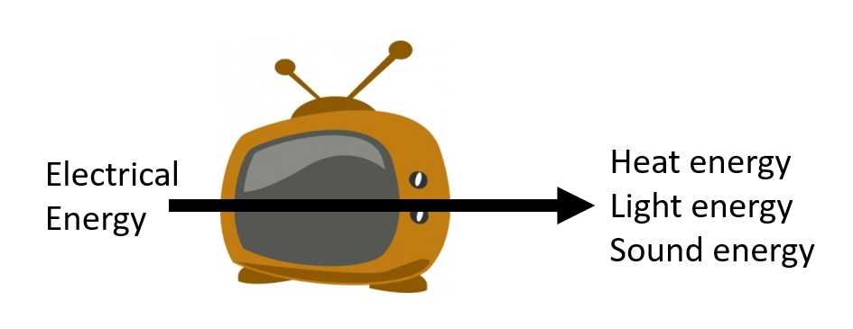
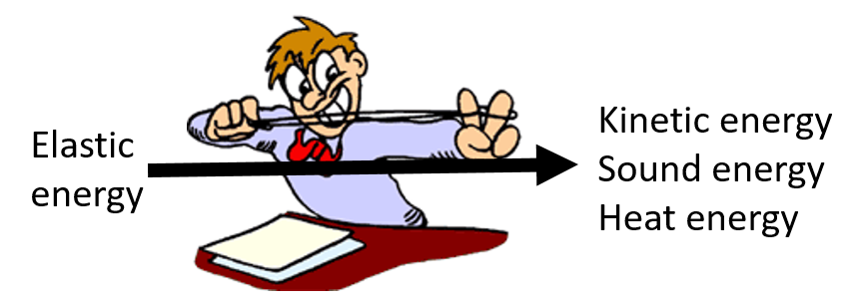
Concept Development
CFU 1
What is energy transformation?
CFU 2
Think, Pair, Share: describe two other ways that energy can be changed from one form to another.
Energy Transformation
When one form of energy changes into another form, we say it has been transformed.
Examples
Your TV transforms electrical energy into sound, light and heat energy.
When you release a rubber band, the elastic potential energy is transformed into kinetic and sound energy.

Slide 9
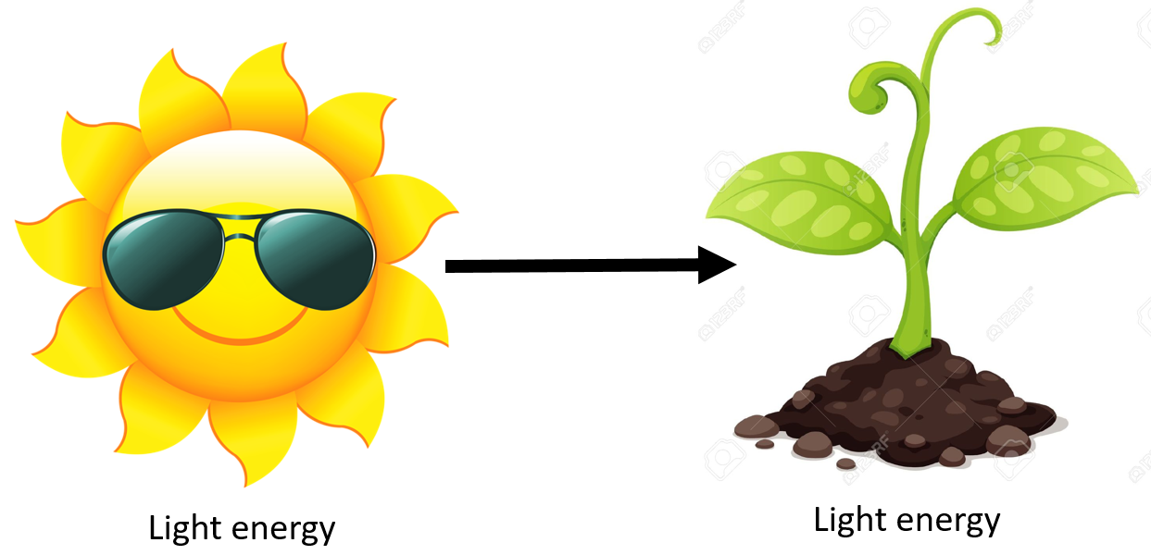
Skill Development / Guided Practice
The Sun shining on a plant
Energy: transferred or transformed?
Has the energy moved without changing form? Yes = transfer Has the energy changed form? Yes = transformation Write a full sentence response: This is energy transfer / transformation because ________ has been moved / changed ________.
This is energy transfer because light energy from the sun has been moved to the plant without changing form.
Reminder
Kinetic: Movement Heat: Warms things up Light: Brightness / lets us see Sound: Vibrating objects / can be heard Electrical: Movement of electric charges Elastic: Stored in compressed / stretched objects Gravitational: Stored in objects high up Chemical: Stored in chemical bonds Nuclear: Stored inside atoms

Slide 10

Skill Development / Guided Practice
A foot pushing a bike pedal
Energy: transferred or transformed?
Has the energy moved without changing form? Yes = transfer Has the energy changed form? Yes = transformation Write a full sentence response: This is energy transfer / transformation because ________ has been moved / changed ________.
This is energy transfer because kinetic energy from the foot has been moved to the pedals without changing form.
Reminder
Kinetic: Movement Heat: Warms things up Light: Brightness / lets us see Sound: Vibrating objects / can be heard Electrical: Movement of electric charges Elastic: Stored in compressed / stretched objects Gravitational: Stored in objects high up Chemical: Stored in chemical bonds Nuclear: Stored inside atoms

Slide 11
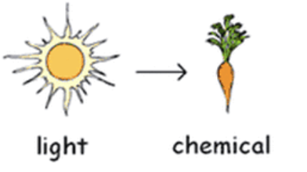
Skill Development / Guided Practice
Energy from the sun being stored in a plant
Energy: transferred or transformed?
Has the energy moved without changing form? Yes = transfer Has the energy changed form? Yes = transformation Write a full sentence response: This is energy transfer / transformation because ________ has been moved / changed ________.
This is energy transformation because light energy from the sun has been changed into chemical energy by the plant.
Reminder
Kinetic: Movement Heat: Warms things up Light: Brightness / lets us see Sound: Vibrating objects / can be heard Electrical: Movement of electric charges Elastic: Stored in compressed / stretched objects Gravitational: Stored in objects high up Chemical: Stored in chemical bonds Nuclear: Stored inside atoms

Slide 12
Skill Development / Guided Practice
Driving a car
Energy: transferred or transformed?
Has the energy moved without changing form? Yes = transfer Has the energy changed form? Yes = transformation Write a full sentence response: This is energy transfer / transformation because ________ has been moved / changed ________.
This is energy transformation because chemical energy from the petrol has been changed into kinetic, sound, and heat energy by the car.
Reminder
Kinetic: Movement Heat: Warms things up Light: Brightness / lets us see Sound: Vibrating objects / can be heard Electrical: Movement of electric charges Elastic: Stored in compressed / stretched objects Gravitational: Stored in objects high up Chemical: Stored in chemical bonds Nuclear: Stored inside atoms

Slide 13


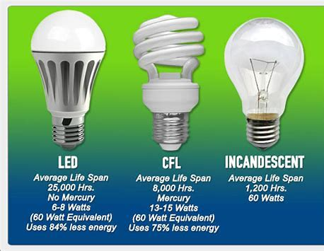
Relevance
Why does energy transfer and transformation matter?
Your bodies rely on energy transformation – chemical energy from your food is transformed into kinetic and heat energy (and others).
Most sports rely on transferring kinetic energy to something (e.g. kicking a ball, throwing a frisbee).
All devices and appliances transform electrical energy into other forms of energy – and the better they are at it, the cheaper they are to run.

Slide 14
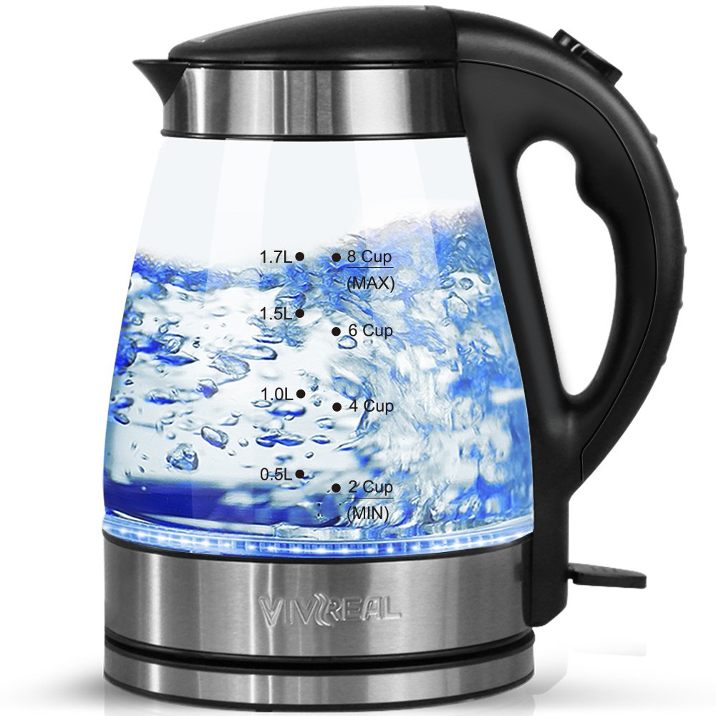
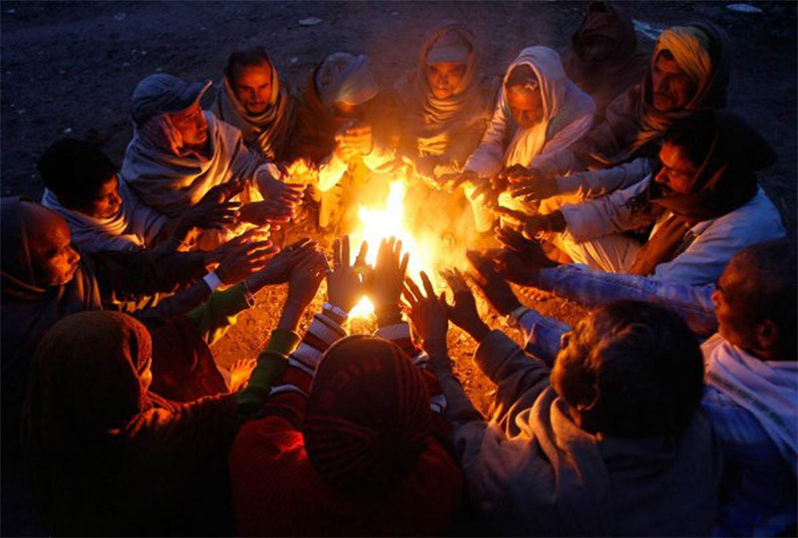
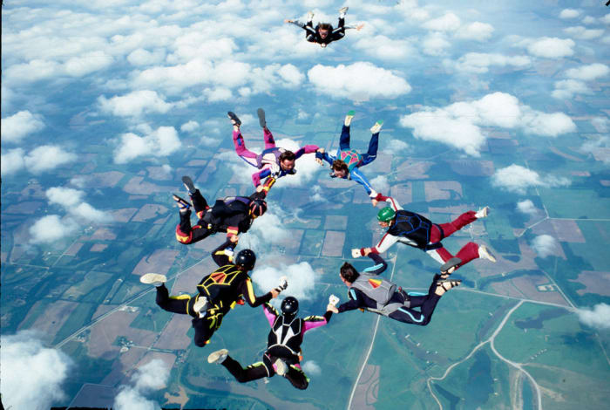
Skill Closure
What is the difference between energy transformation and energy transfer?
Identify whether the energy has been transferred or transformed in the pictures below.

Slide 15
Independent Practice
Energy Transfer Example
The sun shines on a plant. This is energy transfer, because light energy has been transferred from the sun to the plant without changing form.
Describe how energy is being transferred in situations 2 - 4 using full sentences.
The sun shines on a plant.
Two children play on a seesaw.
Electricity travels from a power plant to your house.
You sit down next to a fire.
Describe how energy is being transformed in situations 2 - 4 using full sentences.
A plant uses photosynthesis.
You charge your phone’s battery.
You use your phone to listen to music.
You go skydiving.
Energy Transformation Example
A plant uses photosynthesis. Light Energy → Chemical Energy This is energy transformation, because light energy from the sun has been changed to chemical energy in the plant.
Reminder
Kinetic: Movement Heat: Warms things up Light: Brightness / lets us see Sound: Vibrating objects / can be heard Electrical: Movement of electric charges Elastic: Stored in compressed / stretched objects Gravitational: Stored in objects high up Chemical: Stored in chemical bonds Nuclear: Stored inside atoms

Slide 16
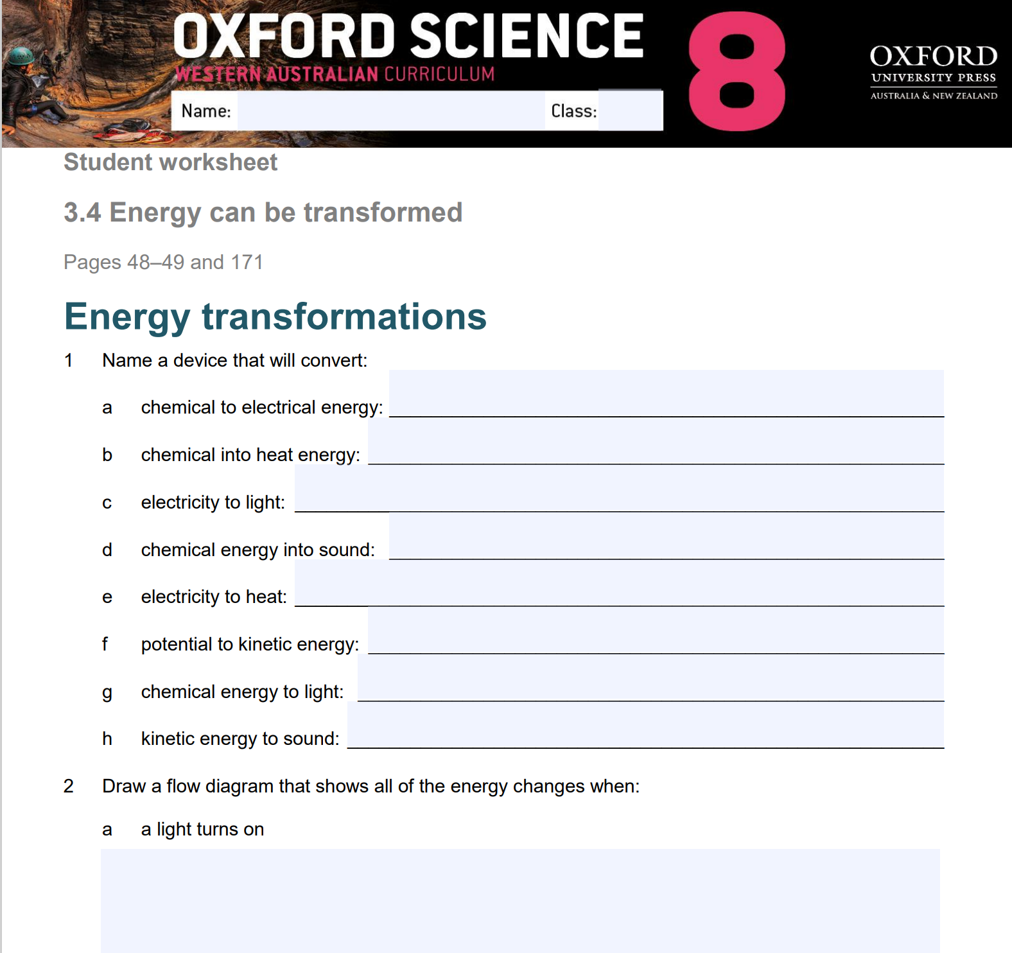
Independent Practice
Complete Oxford Science 8 Worksheet 3.4, pages 1 & 2.

